Slide 1
NF Progress Update: (p)H vs (p)M
Full collaboration group meeting
05/15/2023

Slide 2
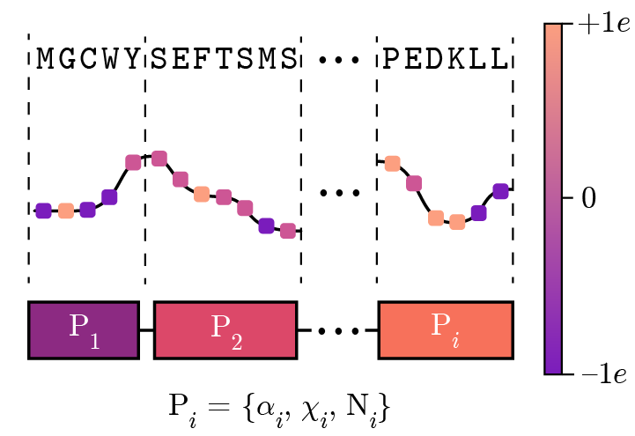
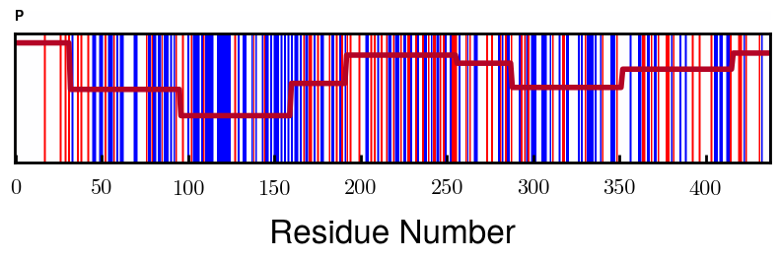
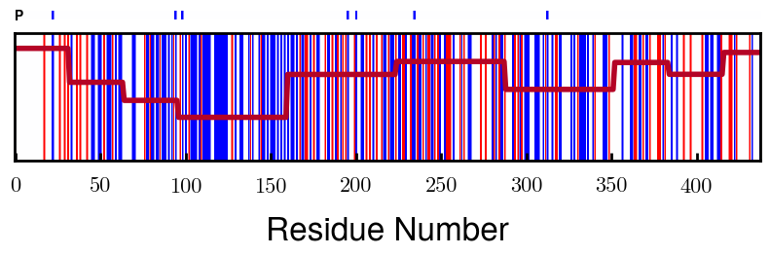
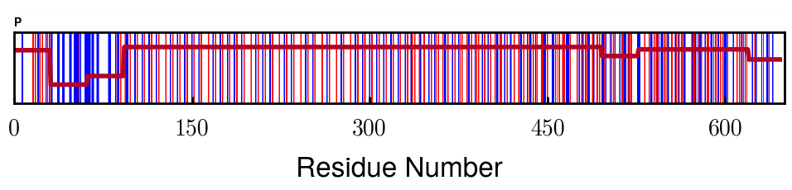
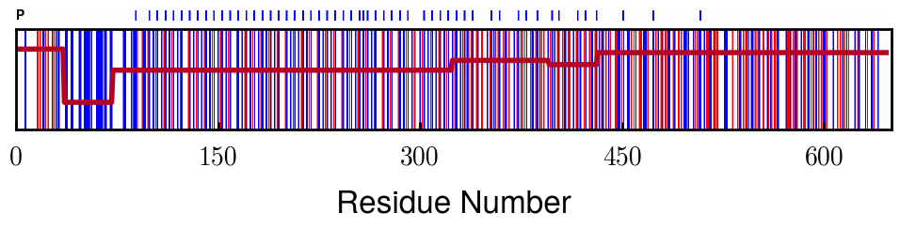
Protein Charge Distribution (Proposed SI)
Block | Alpha | Chi
[0 32] | 0.079143 | 1.275000
[32 64] | -0.186340 | 1.125000
[64 96] | -0.327964 | 1.181250
[96 160] | -0.460694 | 0.787500
[160 224] | -0.124999 | 1.115625
[224 288] | -0.023510 | 0.956250
[288 352] | -0.242085 | 1.00312
[352 384] | -0.031302 | 1.125000
[384 416] | -0.123860 | 1.050000
[416 438] | 0.046945 | 1.281818
Amino acid
Algorithm overview
Charge (at given pH)
Block assignment
NFM
> 0e
= 0e
< 0e
NFH

Slide 3
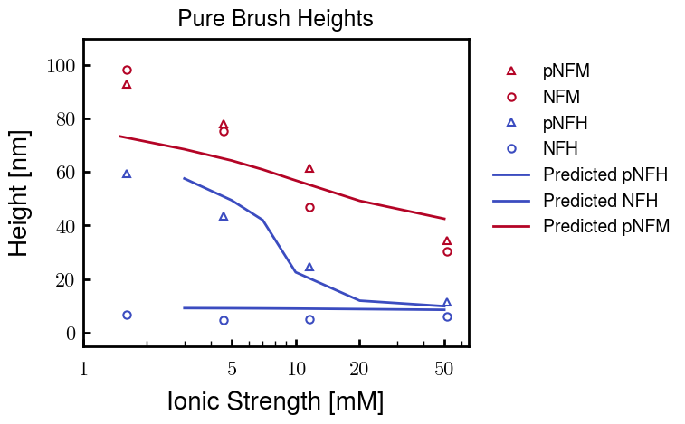
Height comparisons (Proposed Figure)
Notes:
NFH is essentially finished;
Fine tuning for a closer fit
More points to smoothen out pNFH curve
pNFH and NFH use same b, v values
pNFM fitting still in progress
NFM fitting will follow; expecting little difference

Slide 4
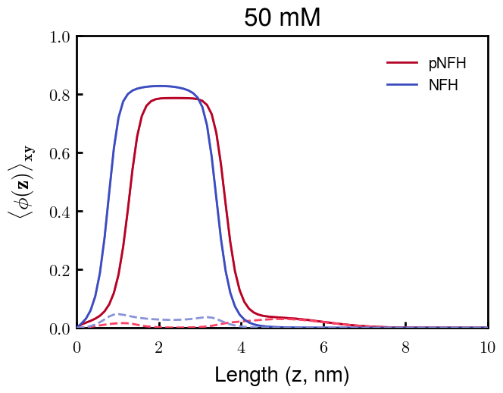
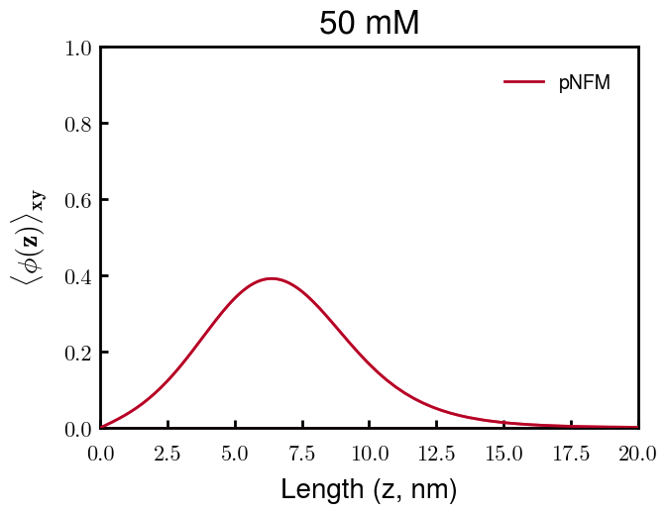
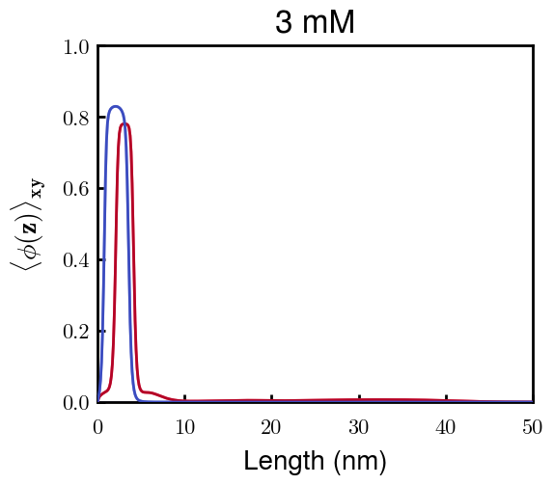
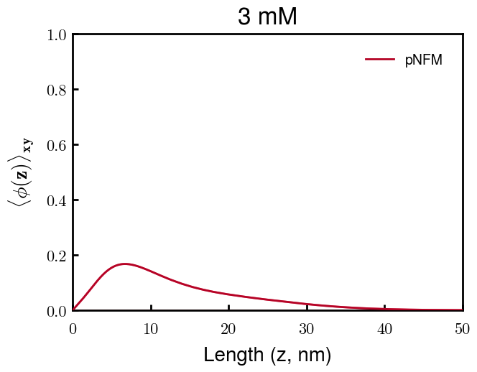
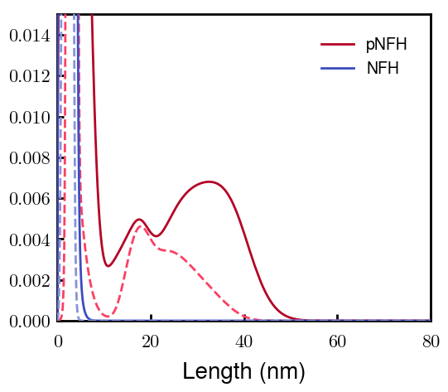
Density profiles (Proposed Figure)
(p)NFH changes:
Blocks 2 and 3 play different roles depending on ionic strength
At high Cs, the inhomogeneously charged block (2) is at the edge of the phos. brush
At low Cs, the phos. block (3) leads the rest of the chain to a dilute outer layer
Block 2 (negative block) dashed
Block 3 (phos block) dashed

Slide 5
Discussion
Height fit (over all Cs) with experimental data gives confidence for calculated density profiles
Coarse-graining (fitting) parameters
b : Kuhn’s statistical segment length (spring equil. distance)
NFH: 0.50 nm, NFM: 3.00 nm
v : Volume of Kuhn’s segment (spring volume)
NFH: 0.20 nm³, NFM: 2.00 nm³
Stiffness parameter, p = b³/v (spring constant)
NFH: 0.625, NFM: 13.5
b

Slide 6
Next Steps
Fine tuning of parameters for best fit with height profiles of L-H brush
Role of charge distribution of NFH at biological pH
Charge of heterogeneous negative block of NFH (blocks 2 & 3)
L-H brushes after phosphorylation
L-M brushes (once experiments are finished)

Slide 7


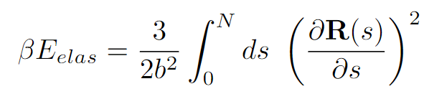
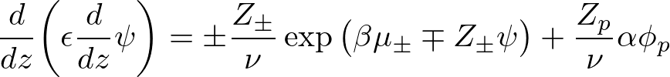
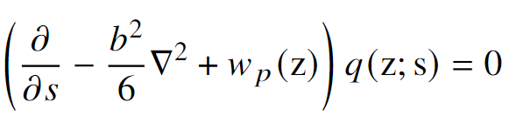
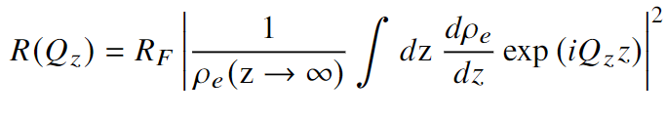
Equations

Slide 8
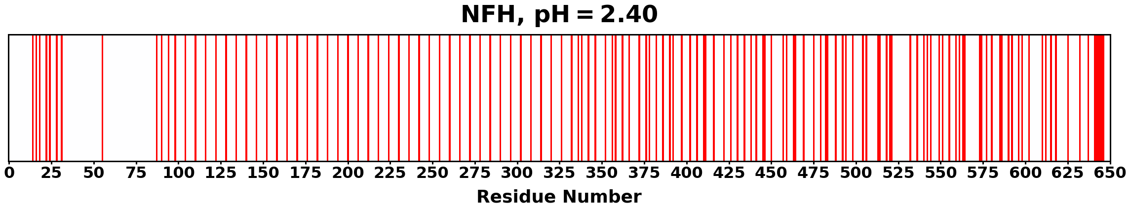
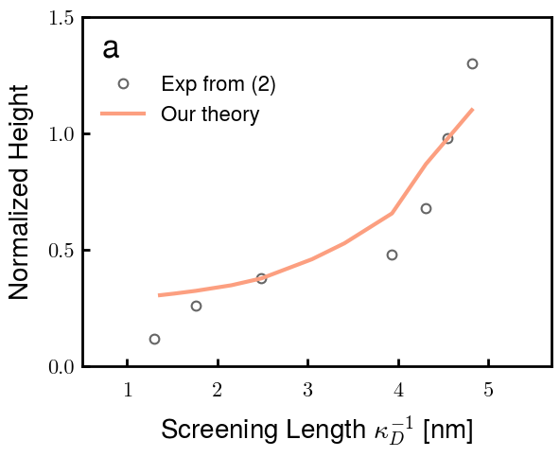
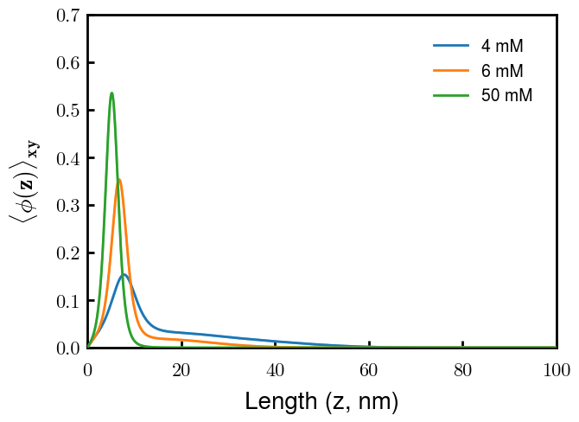
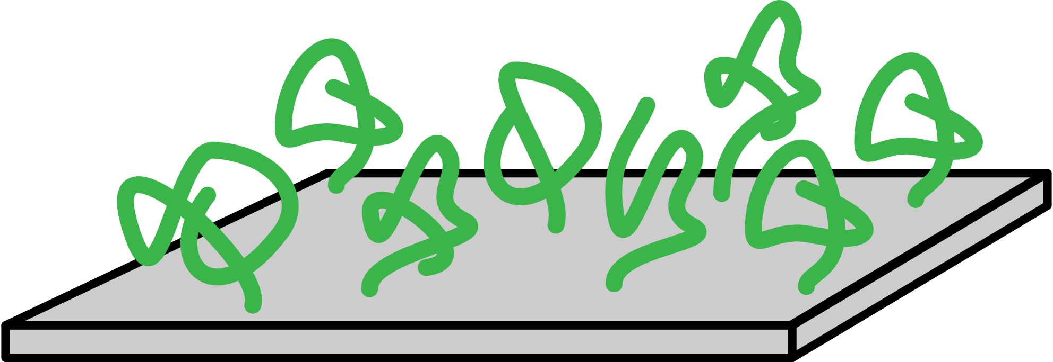
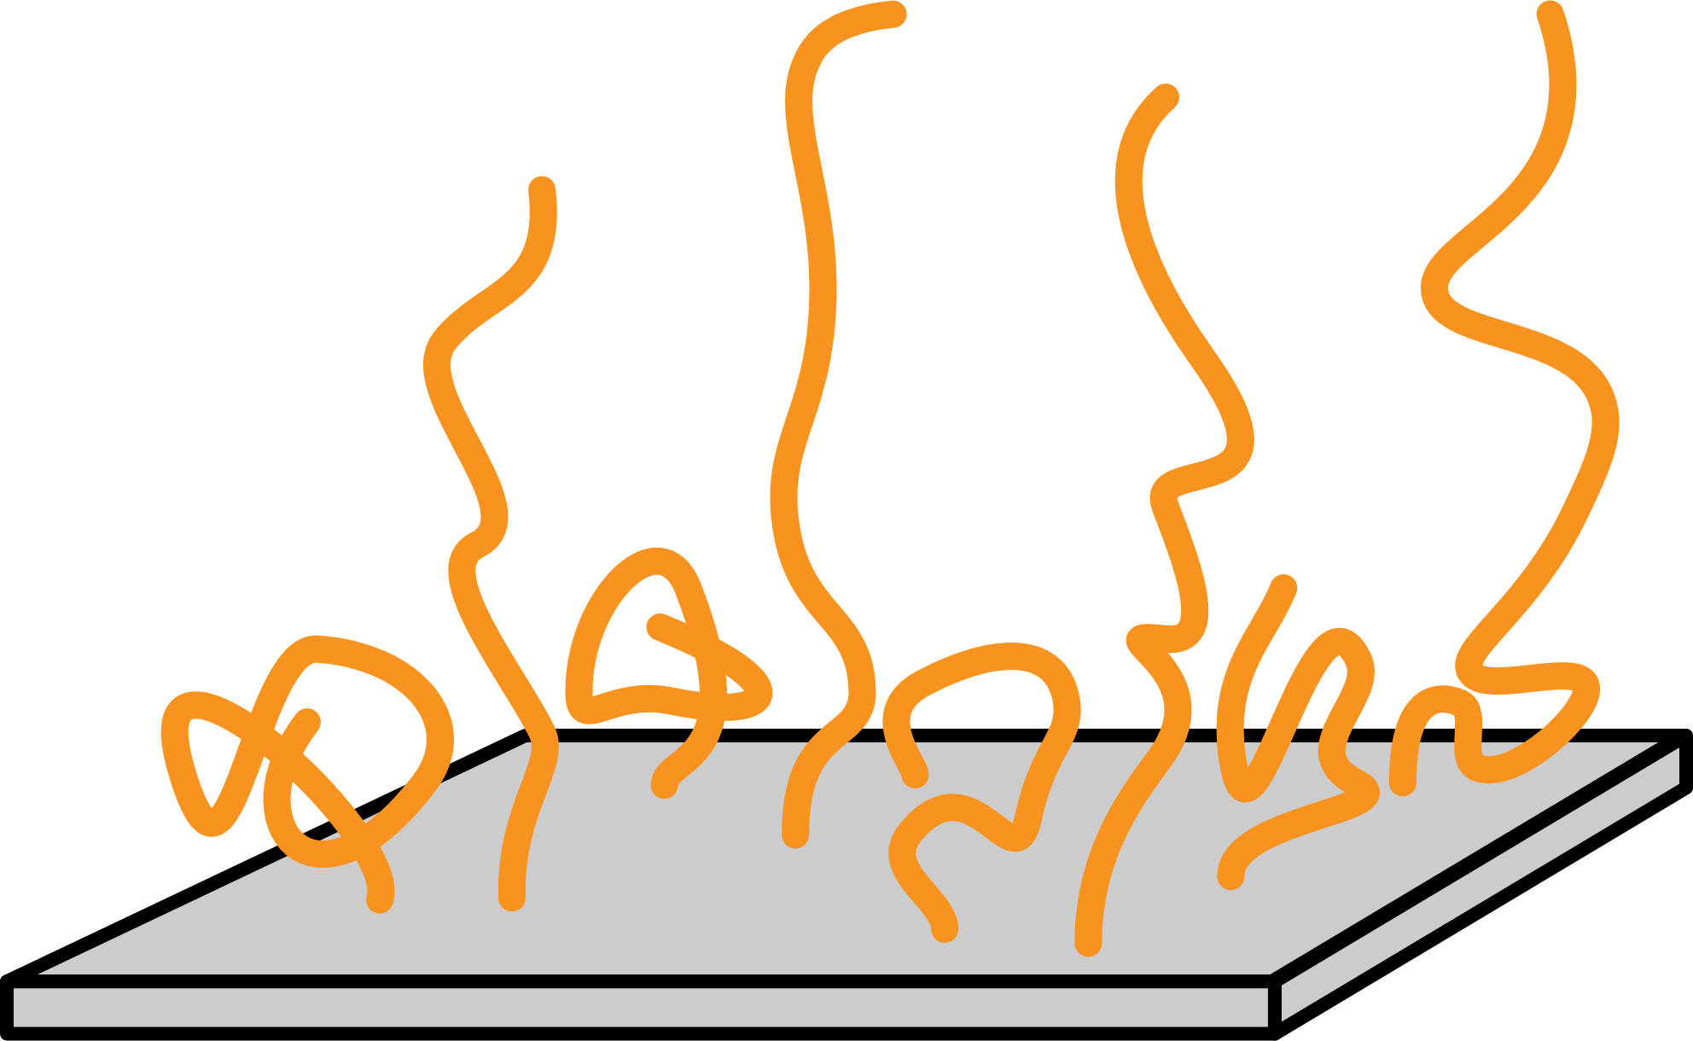
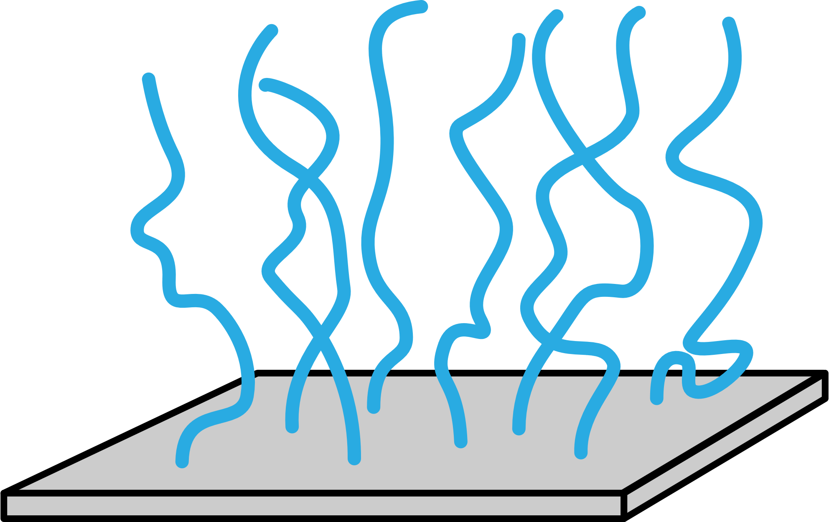
Summary of Model Capabilities (Srinivasan 2014)

Slide 9
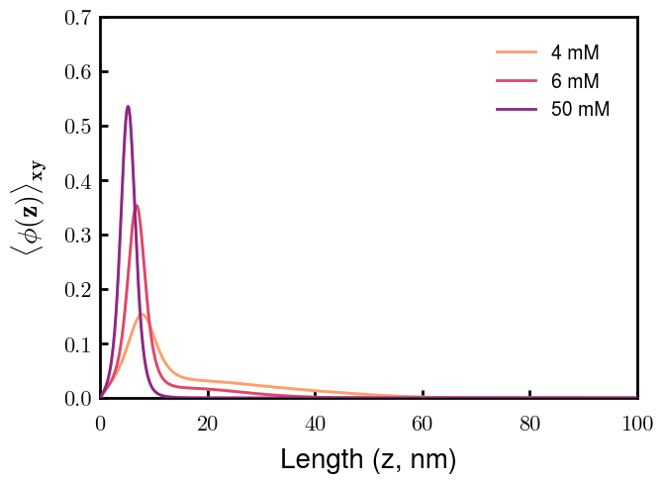
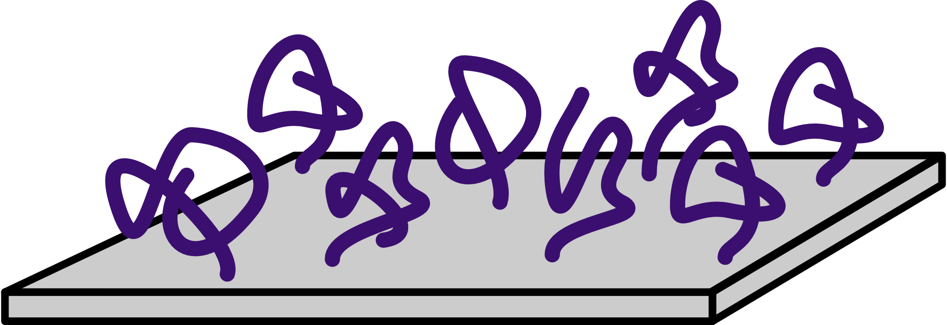
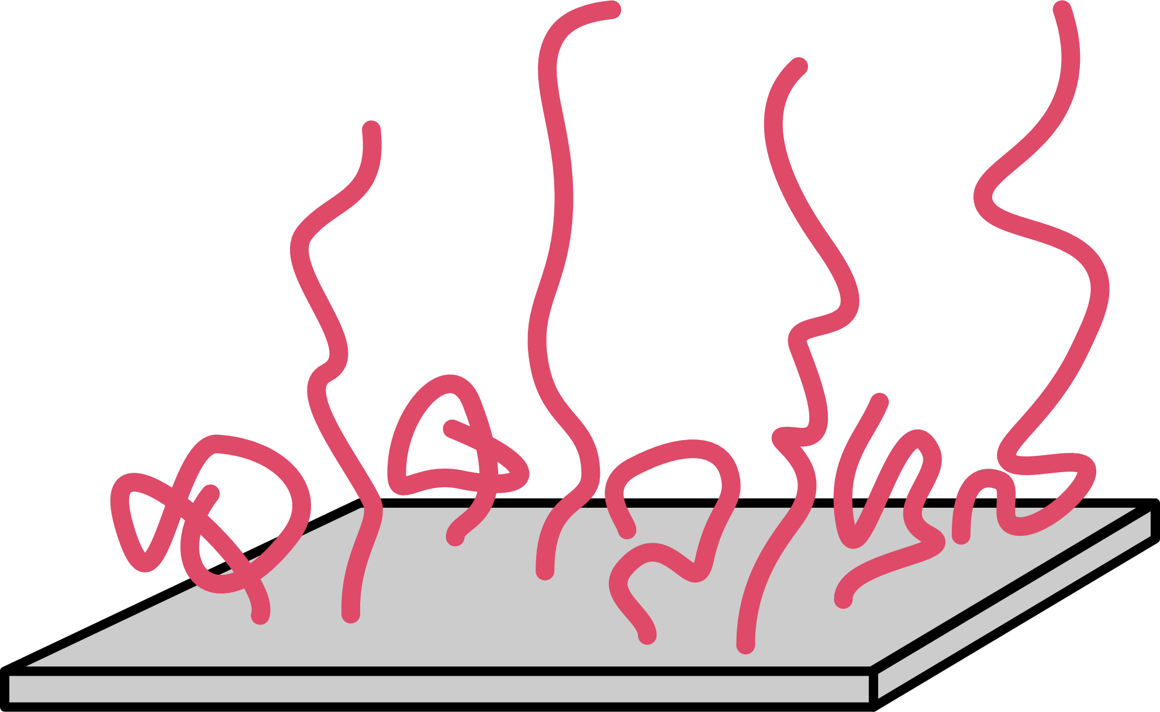
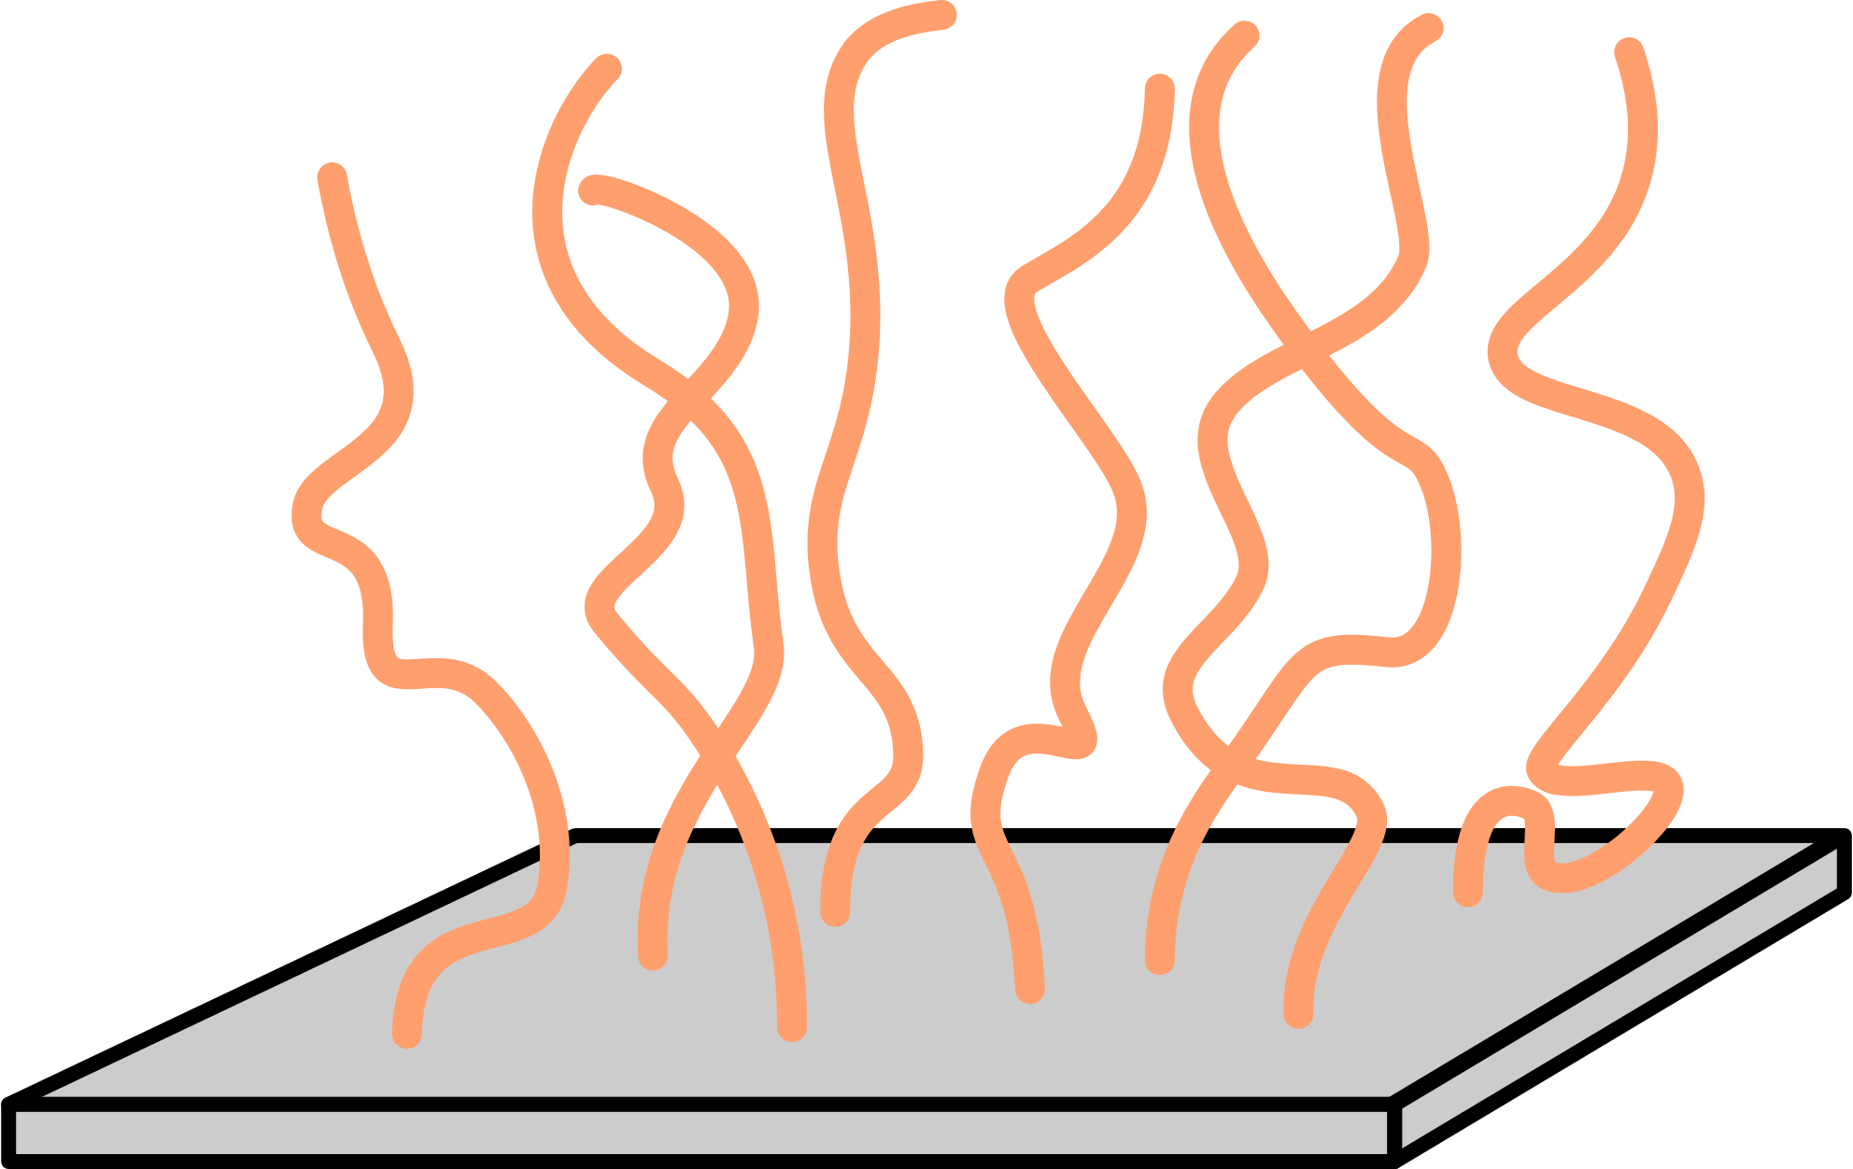

Slide 10
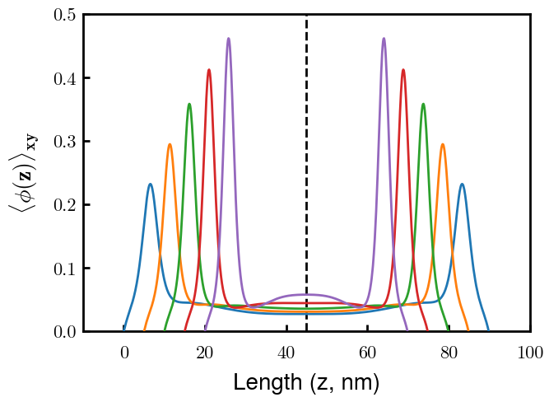
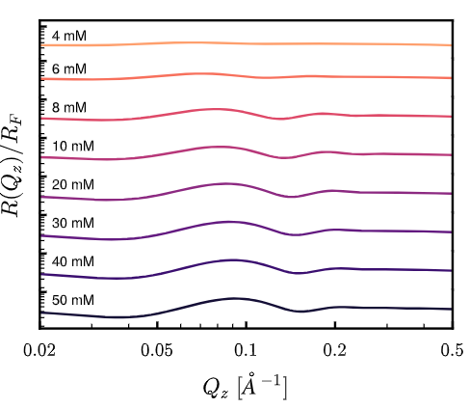
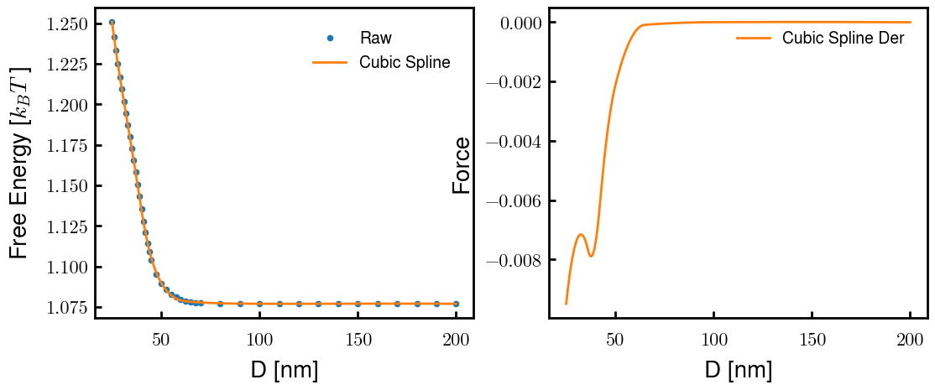
Characterization
Interacting Brushes (4 mM)
Reflectivity Spectra
Emergence of inner condensed phase

